Slide 1


NYC Systems Change and Inclusive Opportunities Network (NYC SCION)

Slide 2
Access Check

Slide 3
NYC SCION Mission & Goals
Our Mission:
To improve the participation of individuals with disabilities, including individuals with intellectual and developmental disabilities, in the workforce and improve their employment outcomes via a sustainable, job-driven, inclusive model that involves business and workforce demands.
Goals:
Creation of access to accessible trainings and opportunities for jobseekers with disabilities
Provide trainings on disability awareness and other disability related topics to businesses
Build and Expand businesses that hire diversity for the career centers.

Slide 4
NYC SCION Key Activities
Enhancing Employment Outcomes for people with disabilities via placements in high demand sectors
Expanding Access to Career Center Services for people with disabilities
Career Centers provide physical and programmatic accessibility, and can also provide connections to NYC SCION Program Managers
Provide information in accessible formats, like audio or braille.
Fostering Partnerships and Collaboration
Build cross-sector partnerships with education, government, and community-based organizations.
Outreach, Training, and Partnerships
Partnered with local organizations to reach underserved communities.
Developed programs with industry partners to upskill participants.
Collaborated with stakeholders to enhance service delivery.

Slide 5
NYC SCION Services
Serve as a resource to customers with disabilities and businesses.
Develop Integrated Resource Teams for customers with multiple barriers to employment.
Provide benefits advisement to assist individuals in understanding the financial implications of returning to work.
Notes:
Maricela

Slide 6
NYC SCION Services Continued
Advise on how to effectively promote the participation of individuals with disabilities in career pathways, systems, and programs.
Inform businesses on accommodations, accessibility and disability inclusion strategies.
Partner with businesses and community agencies to support employment and labor market needs.
Improve Employment Outcomes for People with Disabilities
Notes:
Maricela

Slide 7
NYC SCION Systems Change
Strengthen Systems Through Collaboration
Education & Training
Partnering with Employers, Schools, and Communities To build strong connections to expand opportunities.
Facilitate Integrated Resource Teams (IRTs) Support coordinated planning across agencies.
Promote Universal Design Ensure career services and outreach are accessible to all.
Notes:
Maricela

Slide 8
Workforce1 Career Centers (WF1 CC)
Helps New Yorkers prepare for, and connect to, jobs across New York City's five boroughs and in every sector of the economy.
There are 18 WF1 CC in the 5 boroughs that serve approximately 100,000 jobseekers every year. They include:
• 5 Main “Hub” Centers
• 7 Expansion Centers
• 6 Sector Centers

Slide 9
How to Connect With Us

Slide 10
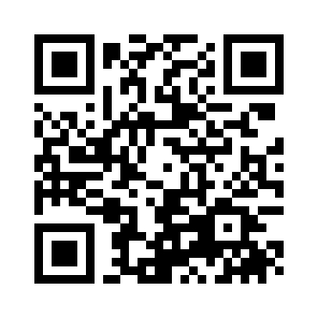
Enrollment in WF1 CC
Must be 18 years or older and live in New York City
Register with local Workforce1 Career Center (WF1CC) in person or online –Login - Worksource1

Slide 11
Enrollment in NYC SCION
Individuals must:
have a recognized disability
be 18 years or older
have a clear career goal and want to utilize Workforce1 Career Center services

Slide 12

Questions

Slide 13
NYC SCION Contact
Maricela Brea, Director, NYC SCION
MBrea@sbs.nyc.gov
Carlos Leon, Program Manager, NYC SCION
CLeon@sbs.nyc.gov
Cheryl Vawdrey, Program Manager, NYC SCION
Cvawdrey@sbs.nyc.gov
Online: Support for People with Disabilities
General Email: NYCSCION@sbs.nyc.gov

